Slide 1
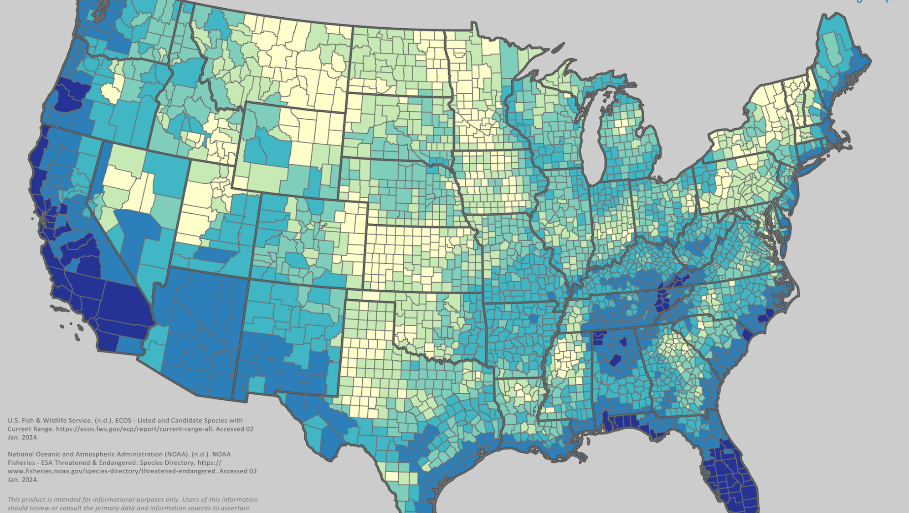
ESA: What’s New in 2026
Taylor Randell Singleton – Extension Sustainability Specialist
University of Georgia (Tifton)
Map provided by Compliance Service International (CSI)

Slide 2
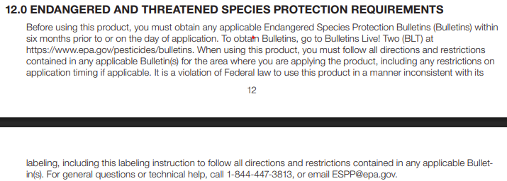
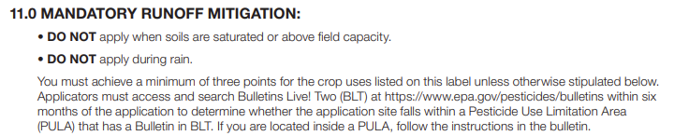
New Label Additions
Three New Sections:
BLT
Are you in a PULA?
Spray drift mitigation
“Mandatory Spray Drift Buffers”
Runoff/erosion mitigation
“Mandatory Runoff Mitigation”

Slide 3
Bulletins & BLT
Geographically specific use restrictions to protect listed species = PULAs
Beyond general label restrictions
BULLETIN
Outlines PULA (pesticide use limitation area) where use is limited; defines additional measures applicator must follow
BLT
“Bulletins Live! Two”
Map-based website for locating PULAs and accessing related bulletins for pesticide applications

Slide 4
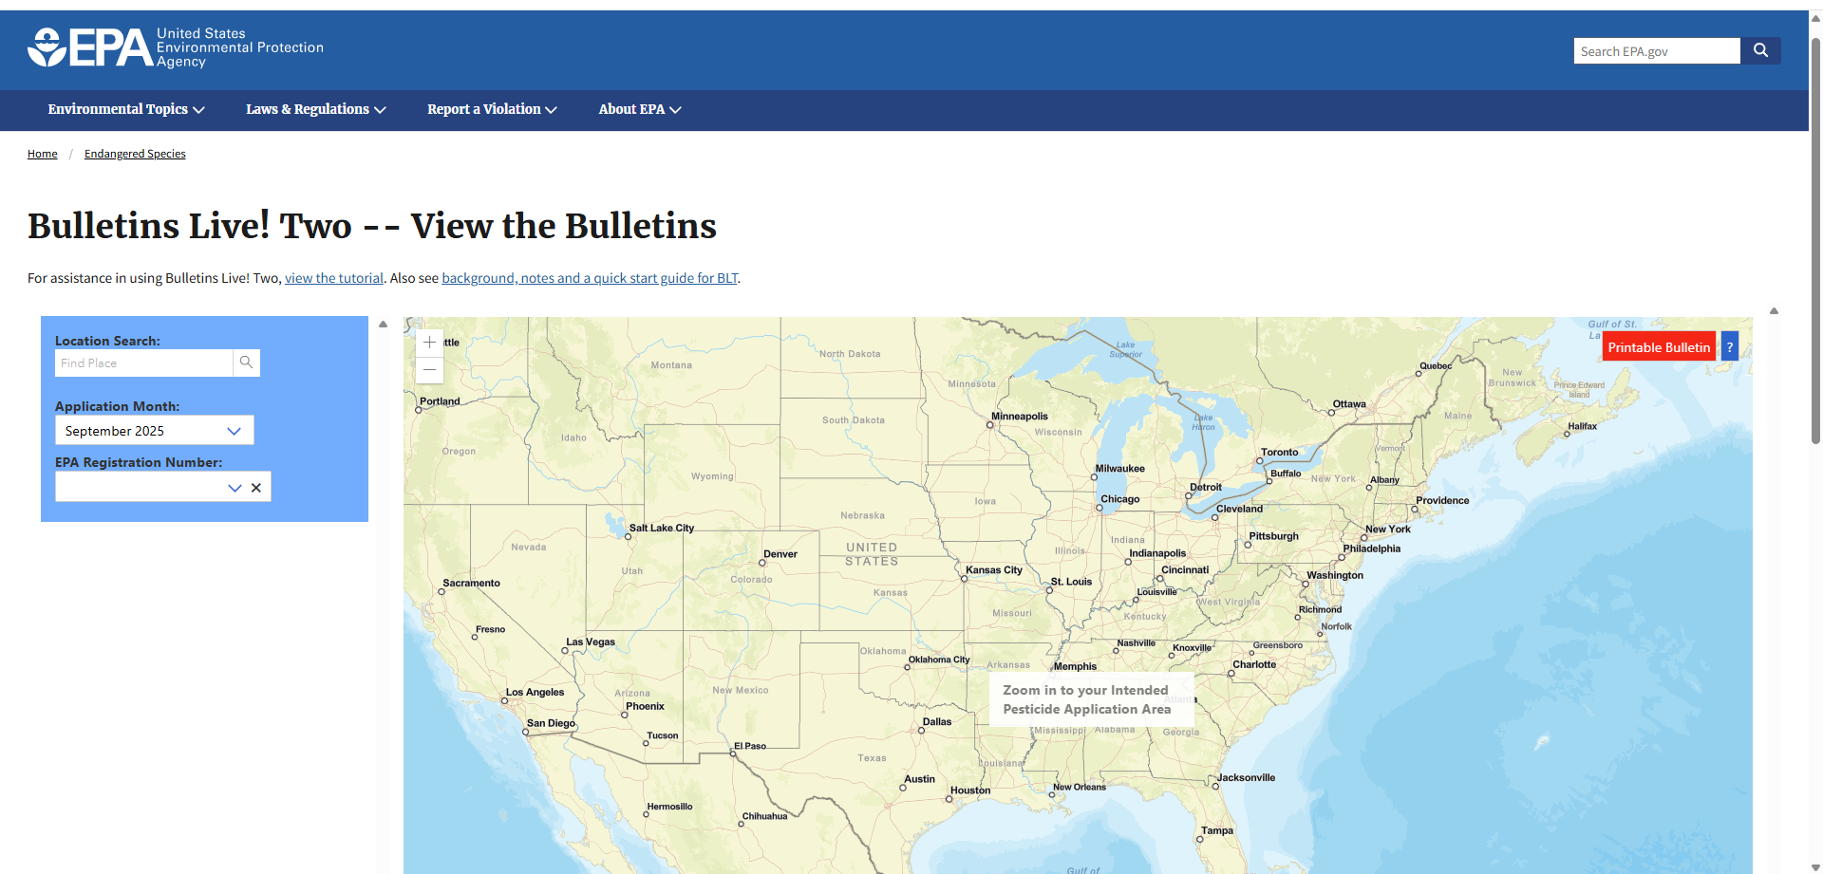
https://www.epa.gov/endangered-species/bulletins-live-two-view-bulletins

Slide 5
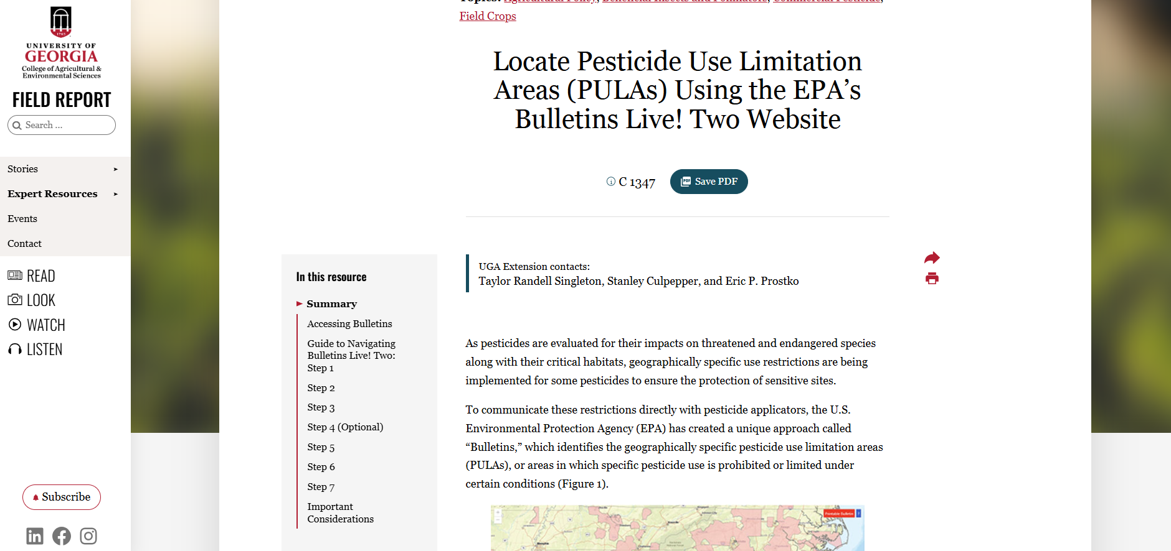
https://fieldreport.caes.uga.edu/publications/C1347/locate-pesticide-use-limitation-areas-pulas-using-the-epas-bulletins-live-two-website/

Slide 6
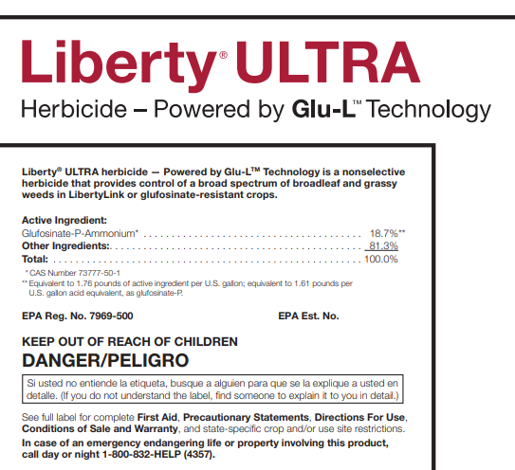
New Label Additions
Three New Sections:
BLT
Are you in a PULA?
Spray drift mitigation
“Mandatory Spray Drift Buffers”
Runoff/erosion mitigation
“Mandatory Runoff Mitigation”

Slide 7
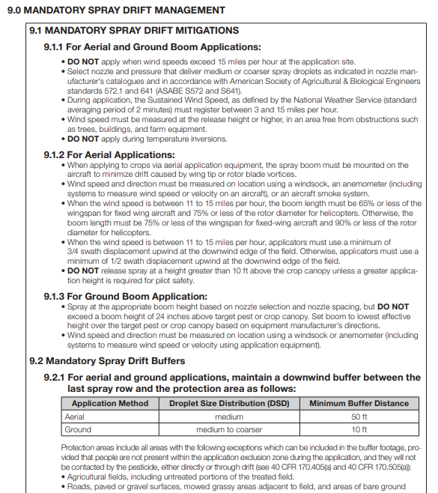
Spray Drift Mitigation
Label will outline what mitigations are necessary:
Mitigate spray drift:
Downwind buffers
Application method dependent
Ground Applications
(0-230 ft – herbicide)
(0-100 ft – insecticide)
Airblast Applications
(0-160 ft – herbicide)
(0-85 ft – insecticide)
Aerial Applications
(0-320 ft – herbicide)
(0-300 ft – insecticide)

Slide 8
Spray Drift Buffer Mitigation
Options available to reduce buffer distance down (100%)
How big is the application?
What kind of application?
Managed area?
Application rate reduction
Droplet size
Boom height
Hooded sprayer/layby/drop nozzles
Adjuvants
Reduced proportion of field
Downwind windbreaks/hedgerows/forests/etc
Humidity

Slide 9
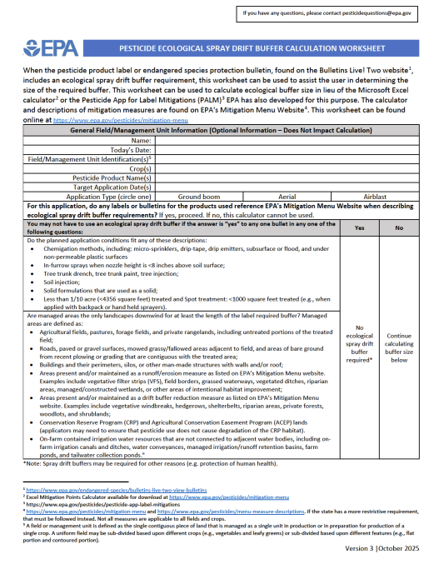
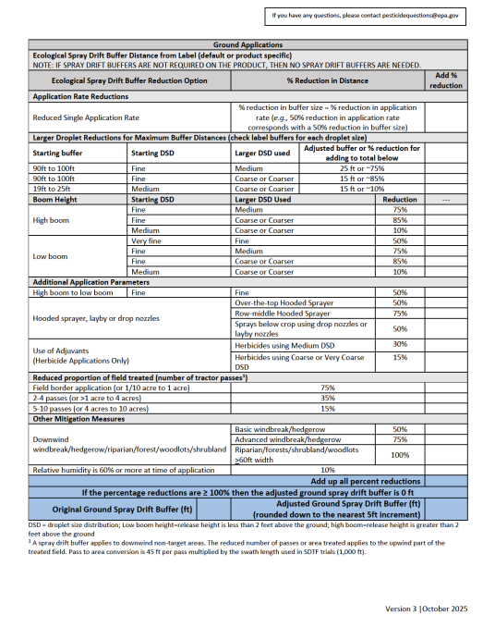
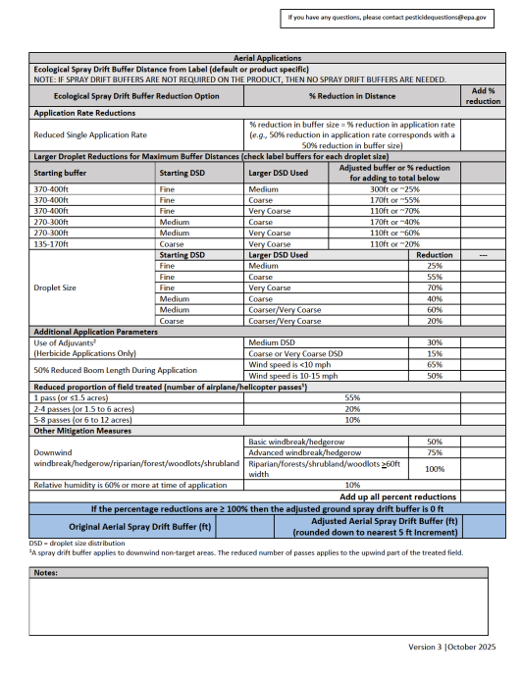
PDF Worksheet Available
https://www.epa.gov/system/files/documents/2025-06/spray-drift-mitigation-worksheet-april-2025-v2.pdf

Slide 10
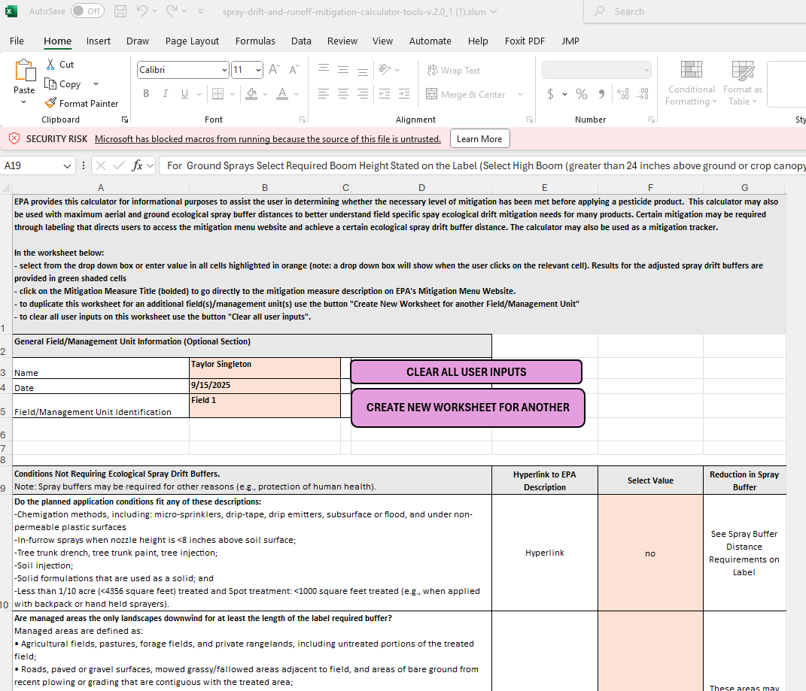
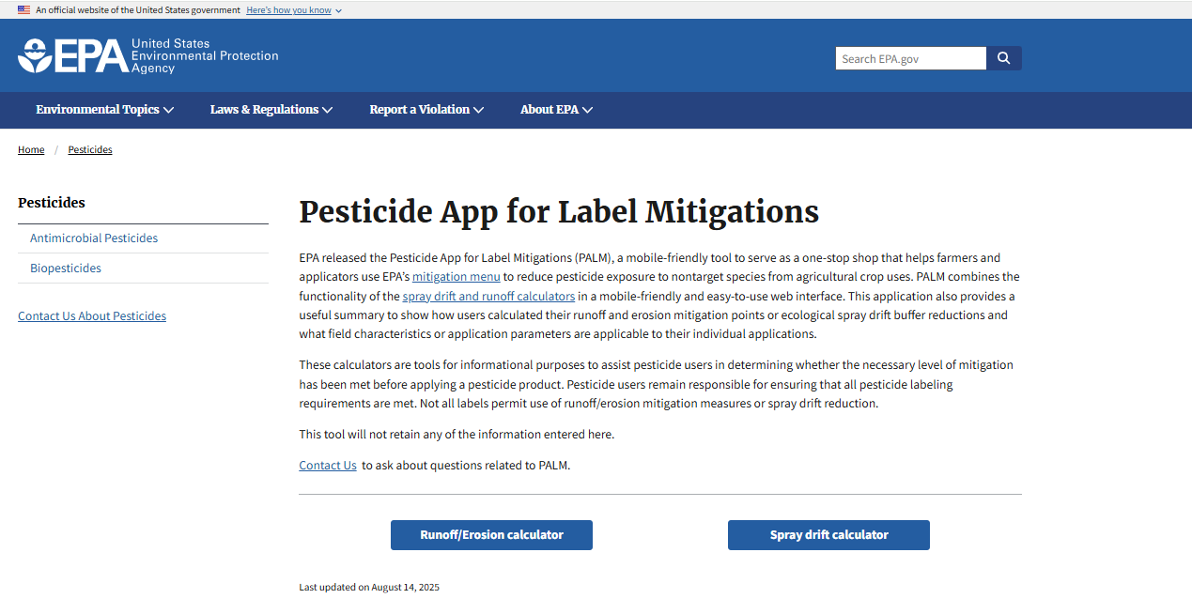
Calculators Available!!!
App – Web-based, mobile friendly….SIMPLE
Excel Spreadsheet – In-depth, downloadable

Slide 11
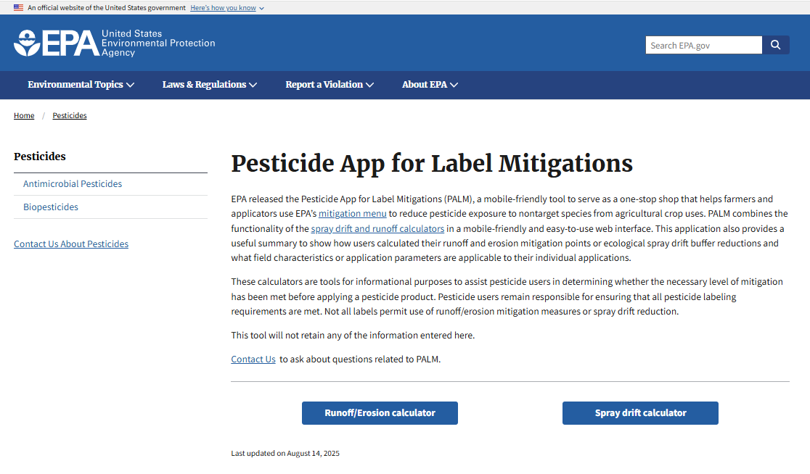
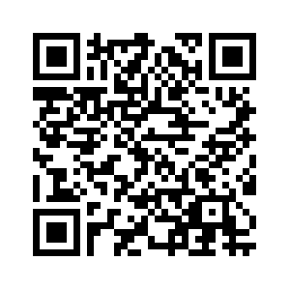
PALM App
Mobile friendly!
https://www.epa.gov/pesticides/pesticide-app-label-mitigations

Slide 12
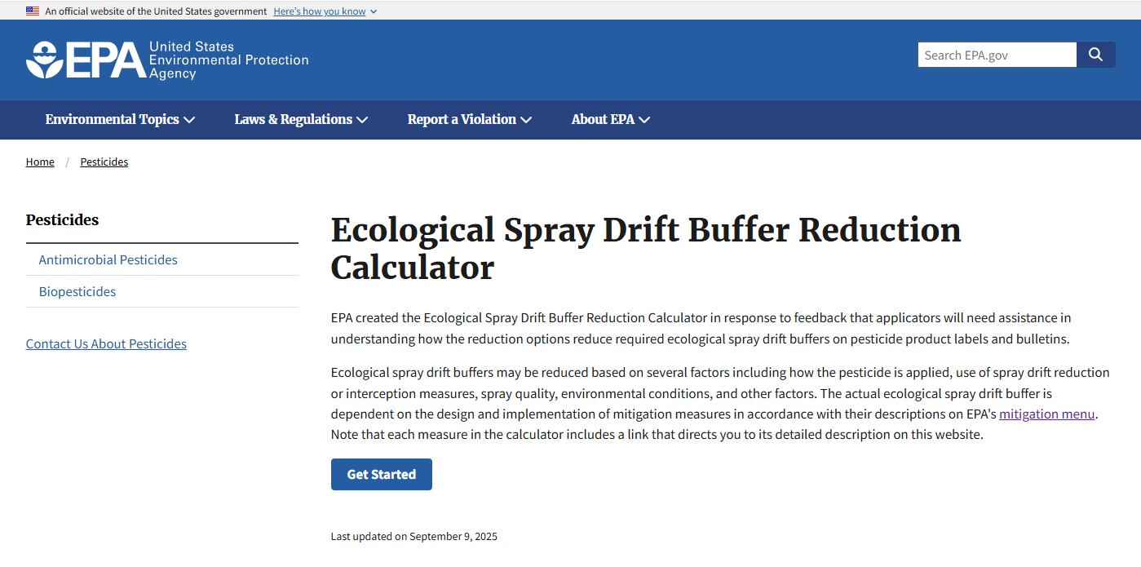
PALM App
Mobile friendly!
https://www.epa.gov/pesticides/pesticide-app-label-mitigations

Slide 13
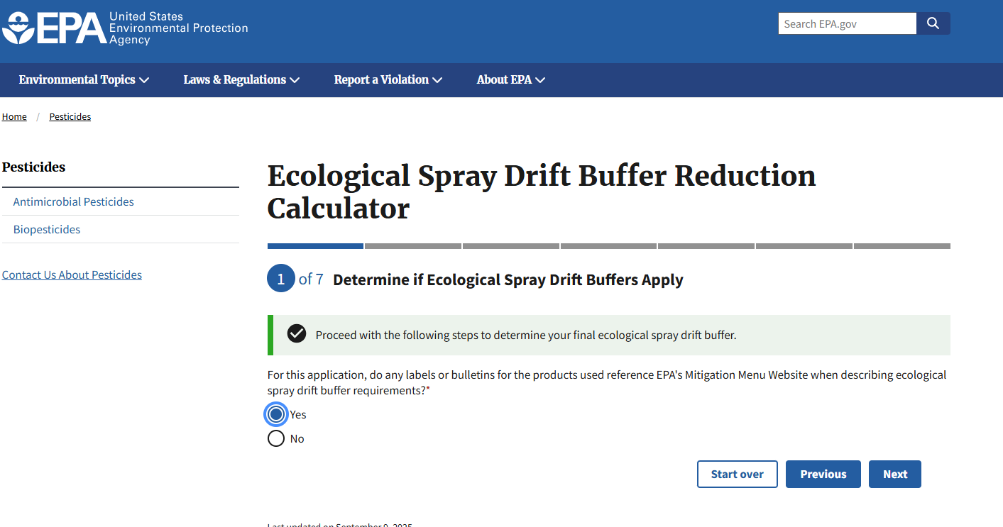
Buffer Reduction Calculator – Ground Example
https://www.epa.gov/pesticides/pesticide-app-label-mitigations

Slide 14
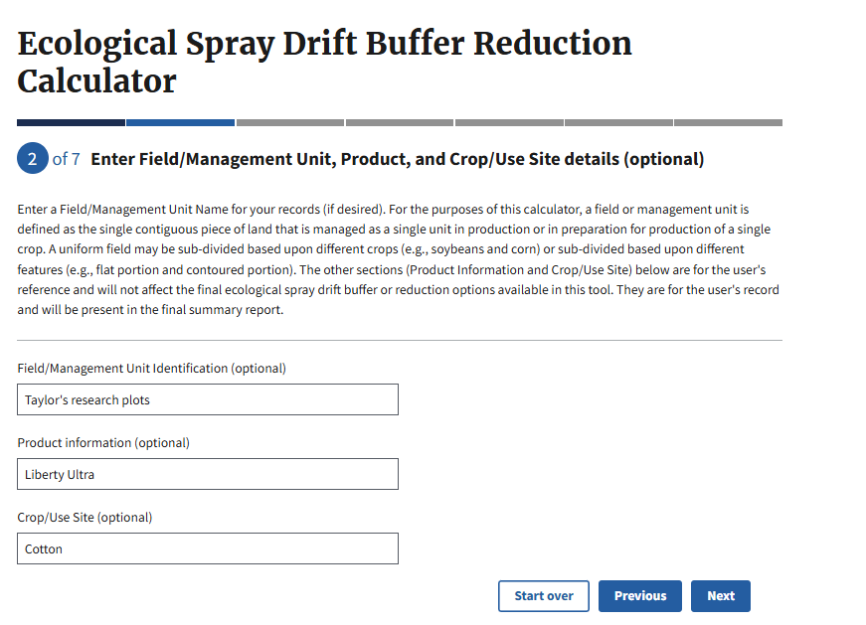
Buffer Reduction Calculator – Ground Example
Can “group” fields
Field is defined as a piece of land managed as a single unit (i.e crop)
Can be divided based on crop, features, etc.

Slide 15
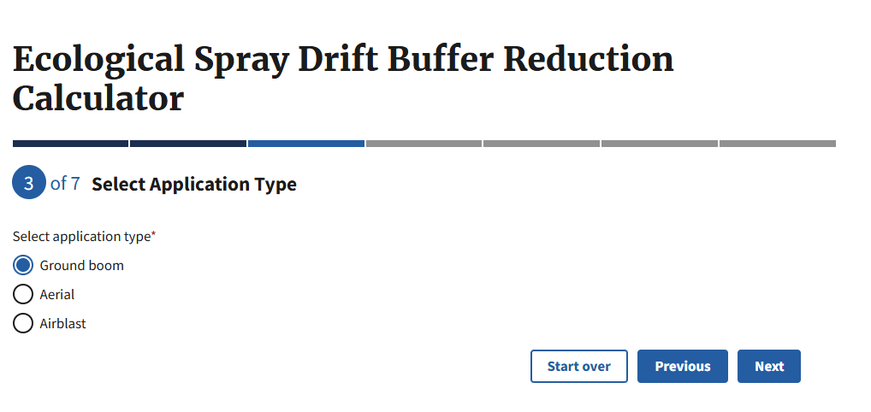
Buffer Reduction Calculator – Ground Example

Slide 16
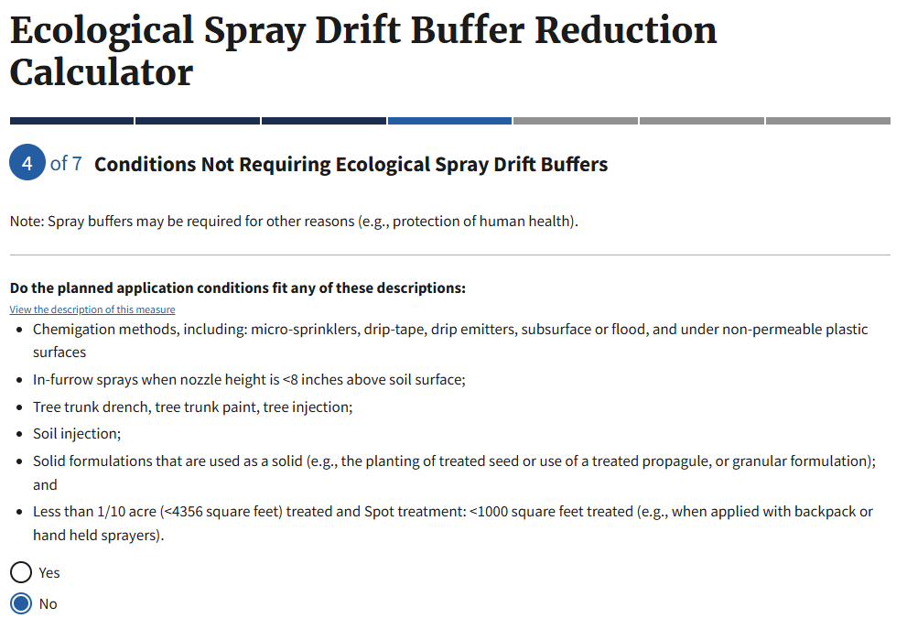
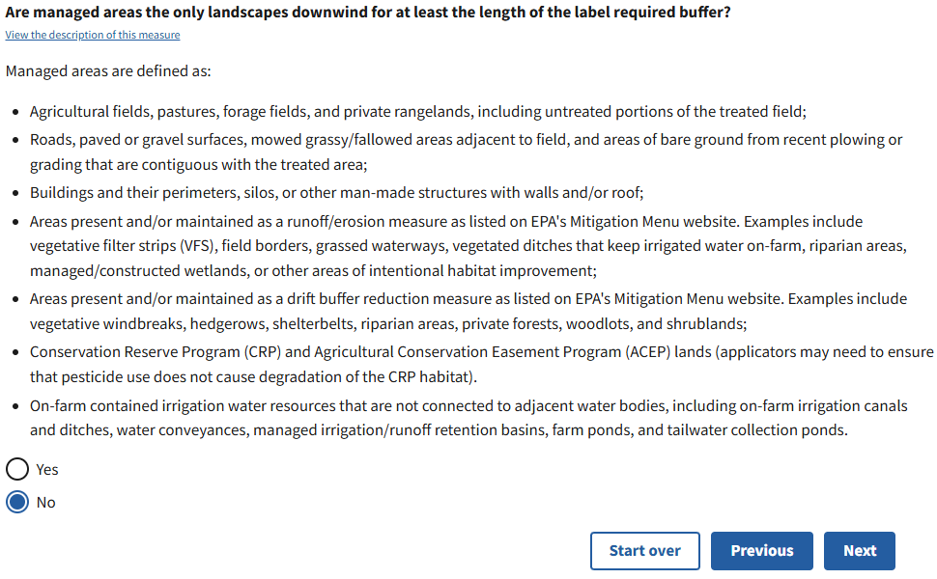
Buffer Reduction Calculator – Ground Example

Slide 17
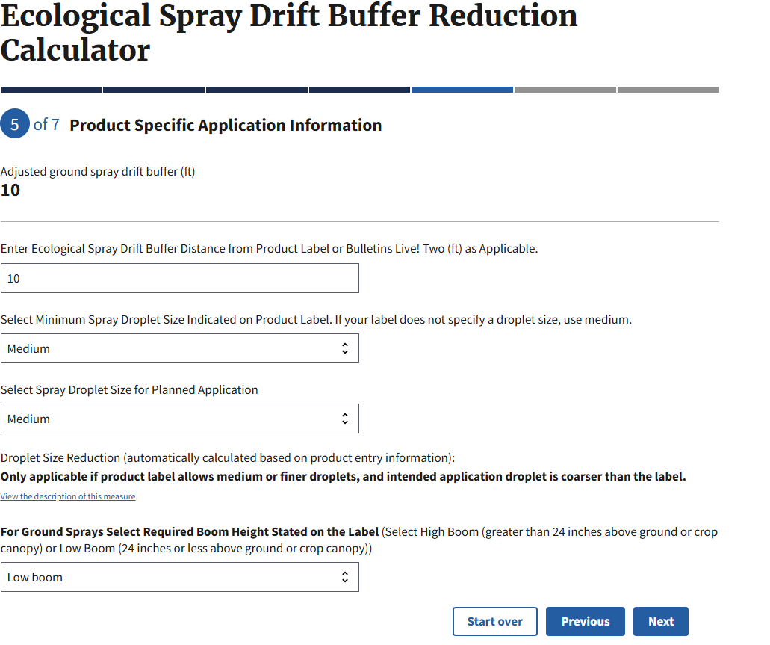
Buffer Reduction Calculator – Ground Example

Slide 18
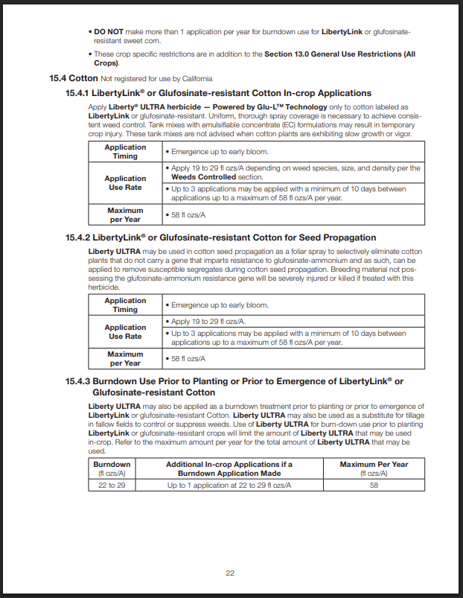
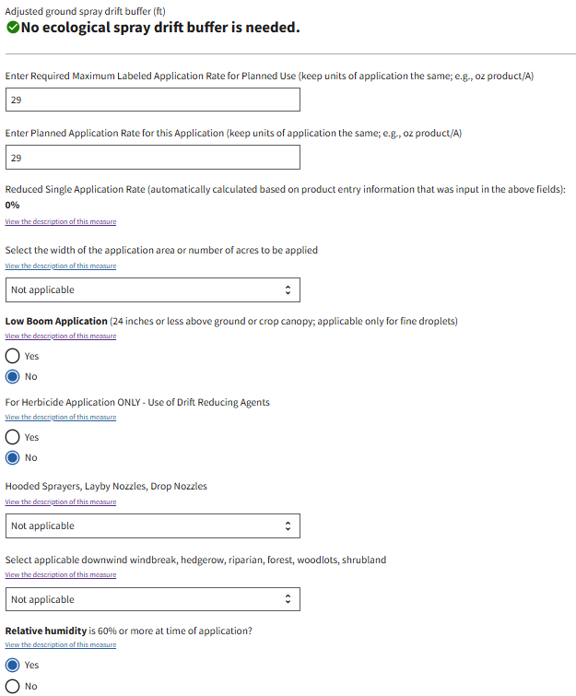
Buffer Reduction Calculator – Ground Example

Slide 19
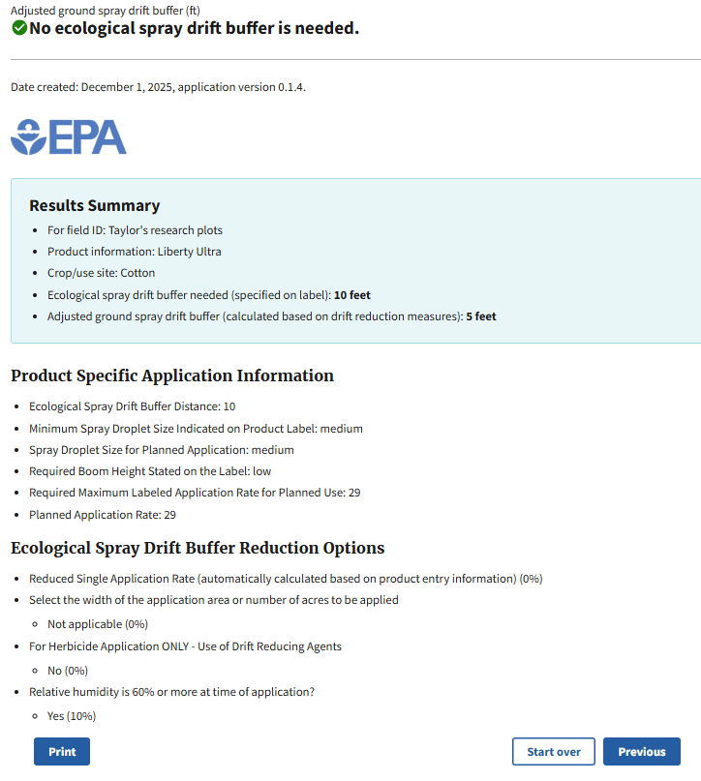
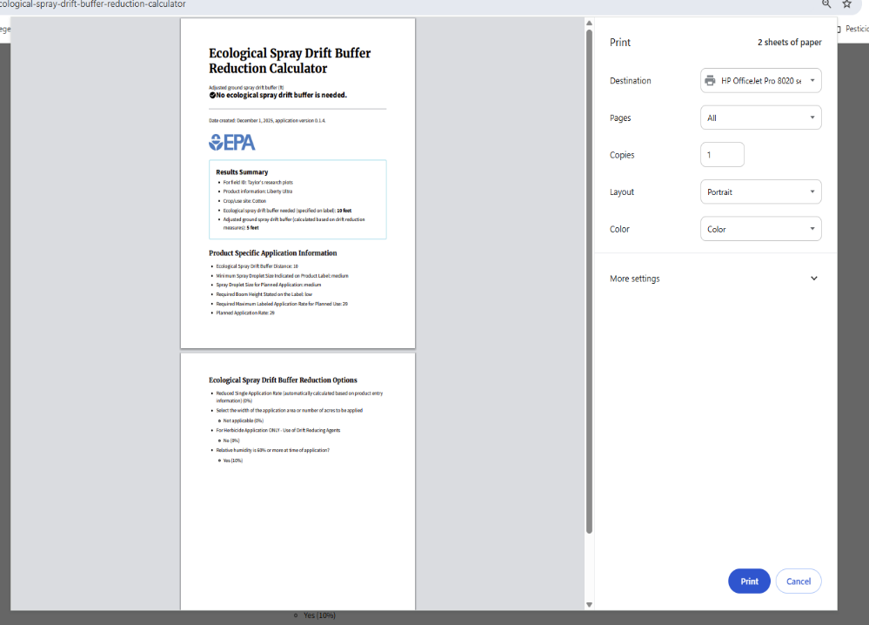
Buffer Reduction Calculator – Ground Example

Slide 20
New Label Additions
Three New Sections:
BLT
Are you in a PULA?
Spray drift mitigation
“Mandatory Spray Drift Buffers”
Runoff/erosion mitigation
“Mandatory Runoff Mitigation”

Slide 21
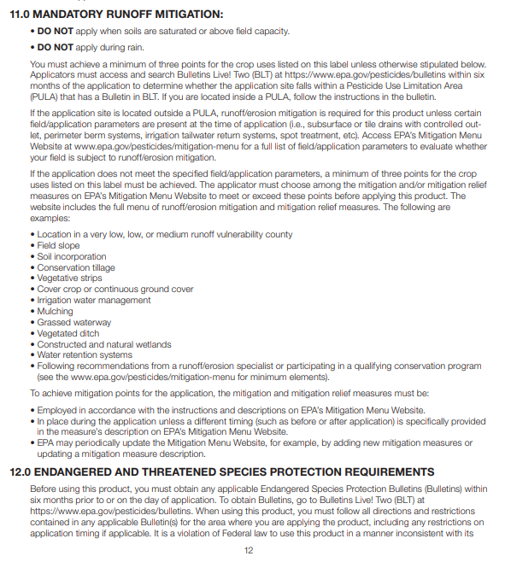
Runoff/Erosion Mitigation
Label will outline what mitigations are necessary:
0-9 points required by label:
Herbicide/use dependent
Potential Reduction? | Points
Low | 1
Medium | 2
High | 3
40+ practices included on the mitigation menu

Slide 22
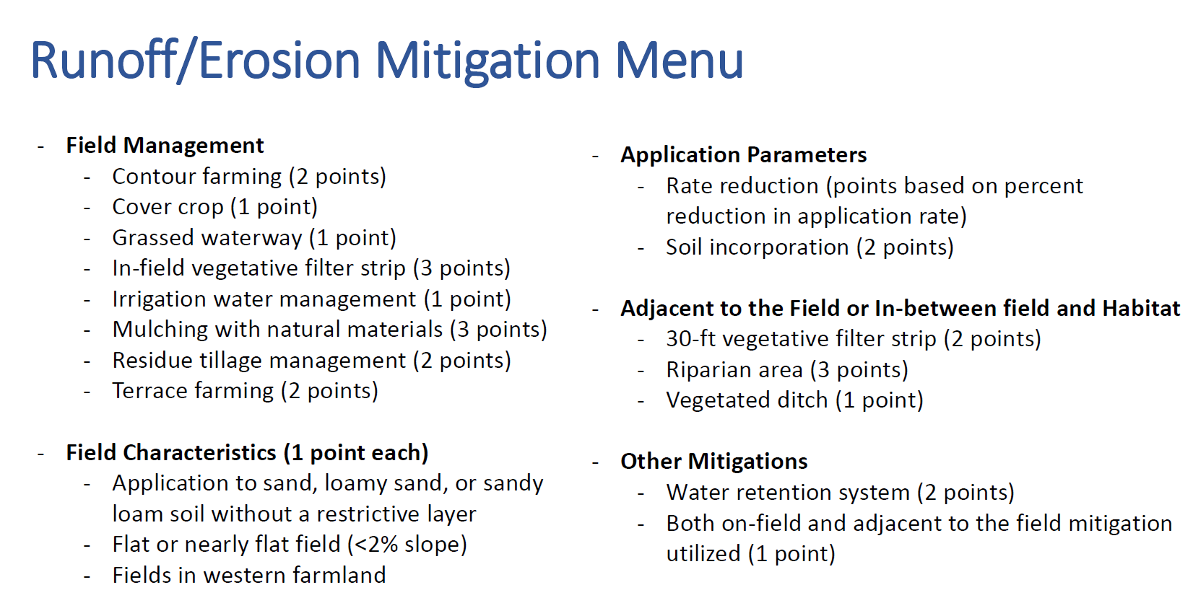
Plus, MORE – Over 40+ options available
U.S. EPA Slide From Herbicide Strategy

Slide 23
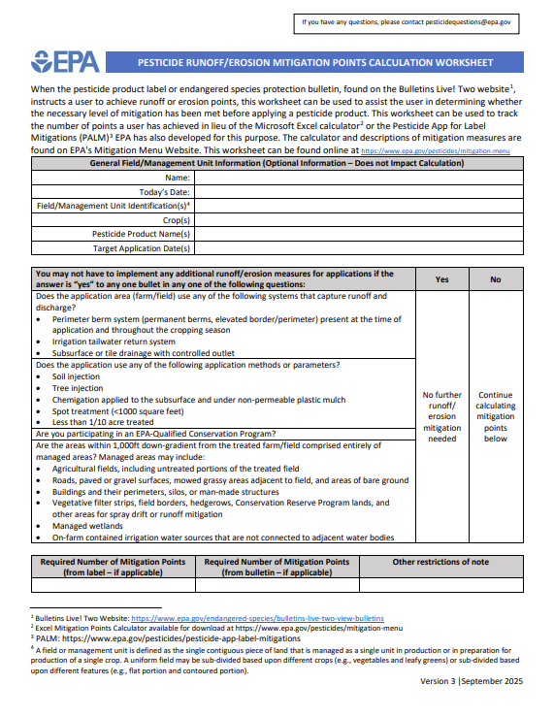
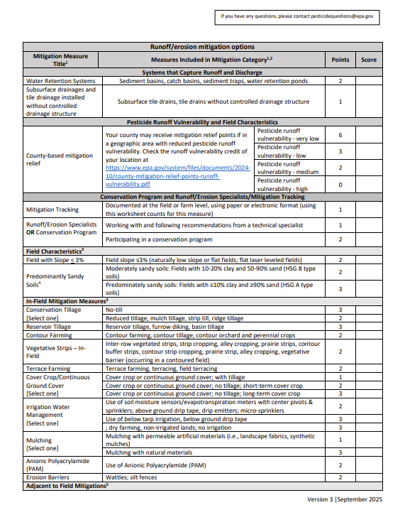
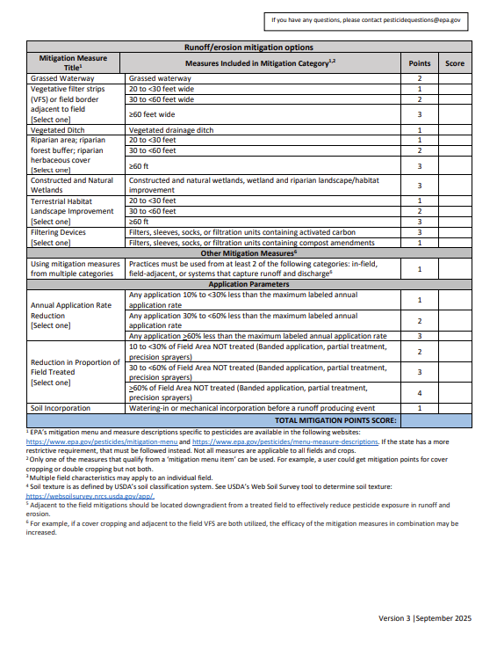
PDF Worksheet Available
https://www.epa.gov/system/files/documents/2025-06/runoff-mitigation-worksheet-april-2025.pdf

Slide 24
PALM App
Mobile friendly!
https://www.epa.gov/pesticides/pesticide-app-label-mitigations

Slide 25
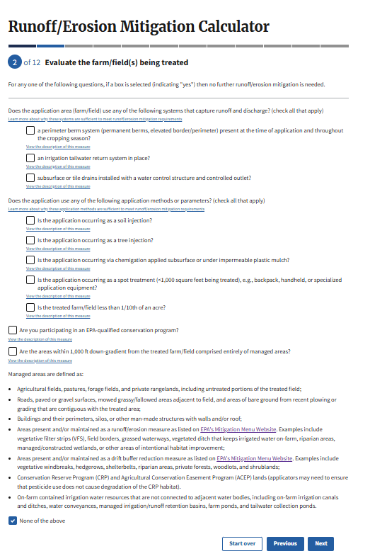
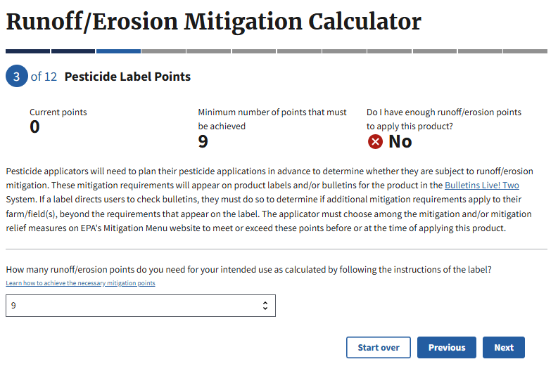
Runoff/Erosion Mitigation Calculation

Slide 26
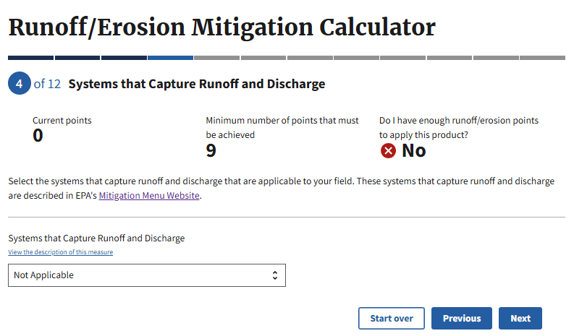
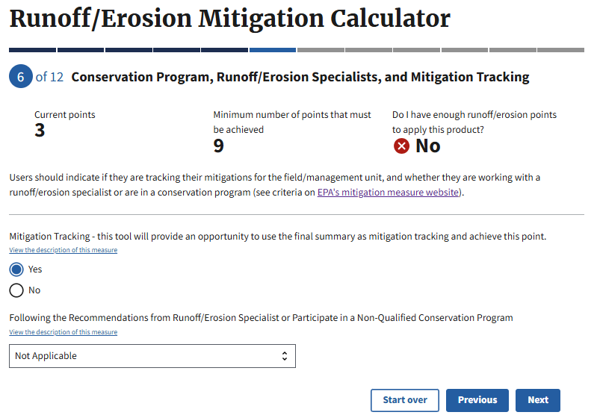
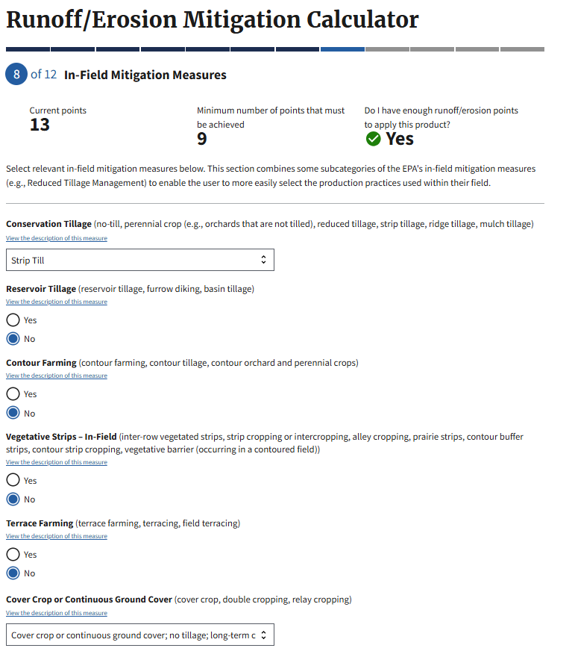
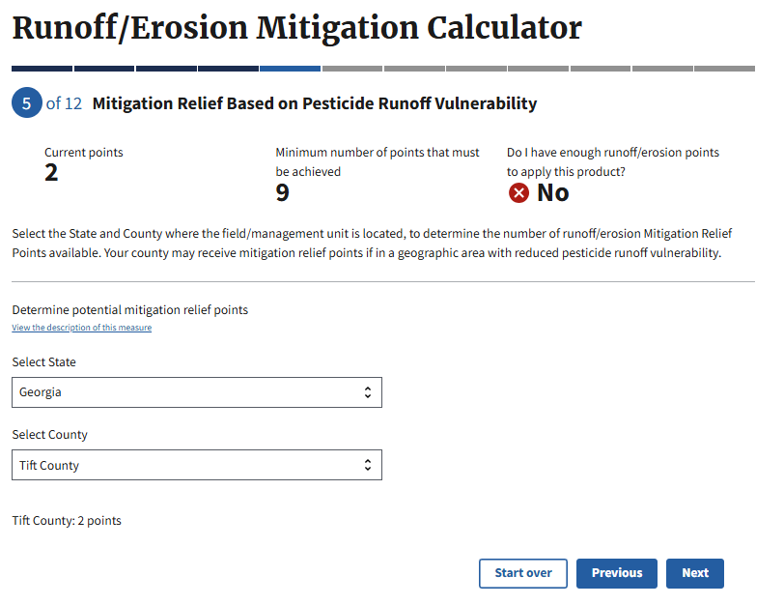
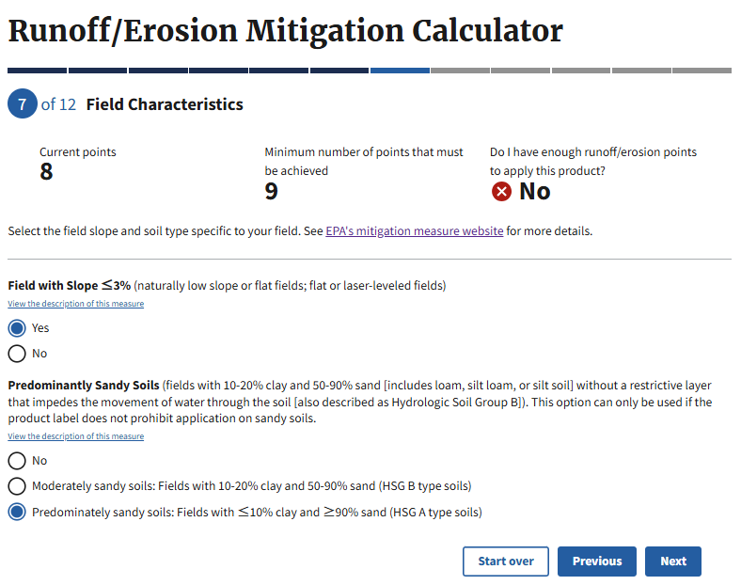
Runoff/Erosion Mitigation Calculation

Slide 27
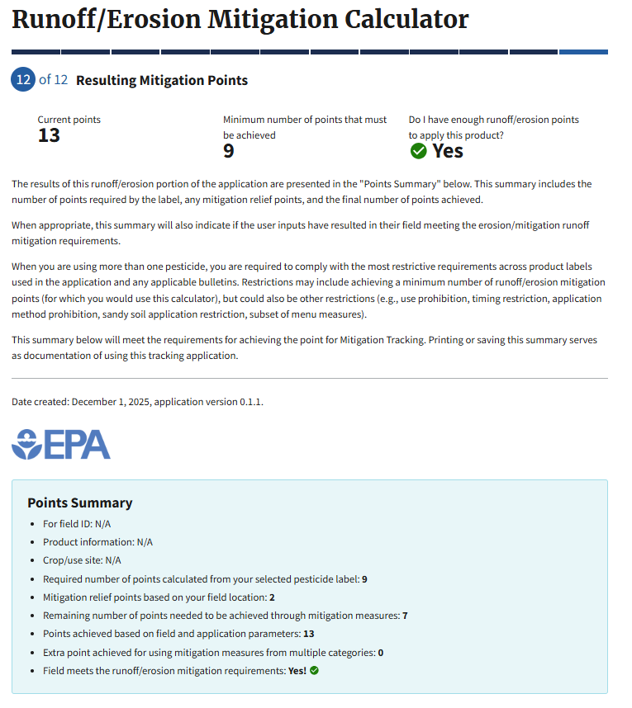
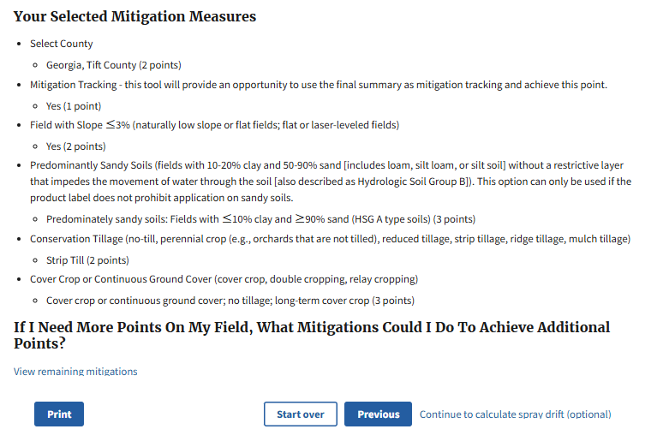
Runoff/Erosion Mitigation Calculation

Slide 28
How to Prepare
Review definitions of mitigation menu options
Read through labels with new mitigation language
Practice navigating BLT if not comfortable – generate bulletins
Bookmark and practice with calculator of choice – either excel or web app
IF COMFORTABLE, feel free to make your own worksheet?

Slide 29
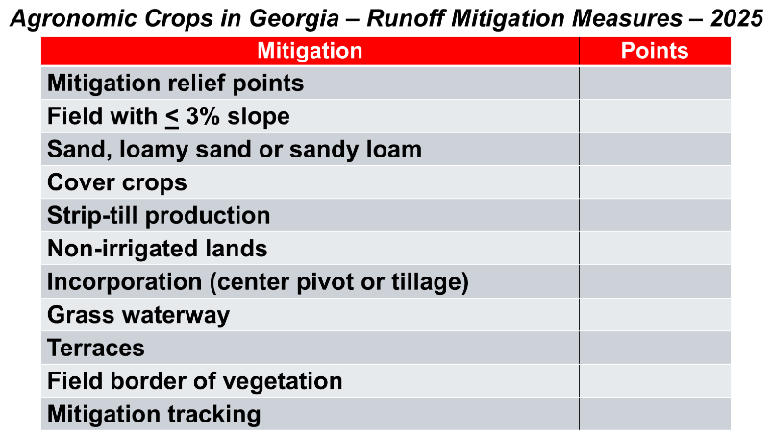
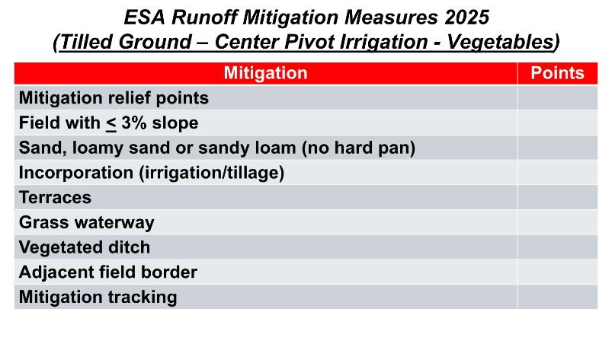
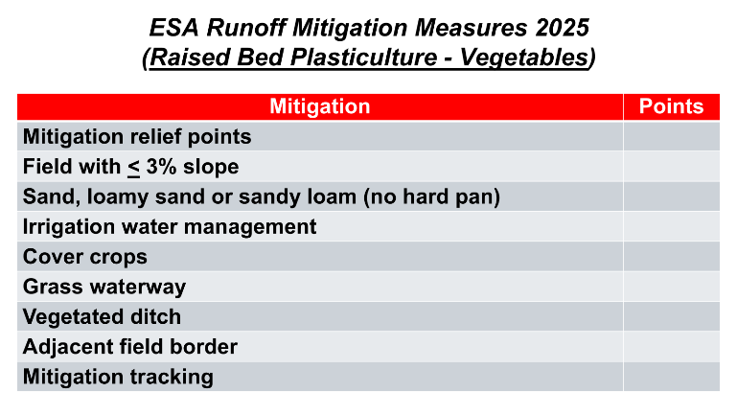
Tailored to Your Specific County?

Slide 30
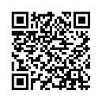
Resources
 | Webpage Link
Pesticide App for Label Mitigations (PALM) | https://www.epa.gov/pesticides/pesticide-app-label-mitigations
Spray Drift – PDF Worksheet | https://www.epa.gov/system/files/documents/2025-06/spray-drift-mitigation-worksheet-april-2025-v2.pdf
Runoff/Erosion Calculation – PDF Worksheet | https://www.epa.gov/system/files/documents/2025-06/runoff-mitigation-worksheet-april-2025.pdf
Excel calculator (direct download) | https://www.epa.gov/system/files/documents/2025-04/spray-drift-and-runoff-mitigation-calculator-tools-v.2.0_1.xlsm
UGA Extension BLT Publication | https://fieldreport.caes.uga.edu/publications/C1347/locate-pesticide-use-limitation-areas-pulas-using-the-epas-bulletins-live-two-website/
CLA Adapting to ESA – Mitigation overview | https://www.youtube.com/watch?v=BWlgBhgephY&list=PLGqU0DXokVsQdGZkr6XhAJluBPEcYsMJ9
CLA Adapting to ESA – BLT | https://youtu.be/_ayFOsYQCLs?si=Wa_-dHkrg4TWK2dJ
CLA Adapting to ESA – Spray Drift | https://youtu.be/V_sM0Q9s2Ho?si=ODokKbsmWWP6BQNn
CLA Adapting to ESA – Runoff | https://youtu.be/2CpXDR23PHw?si=vT2uVaMa9cMWVt08

Slide 31
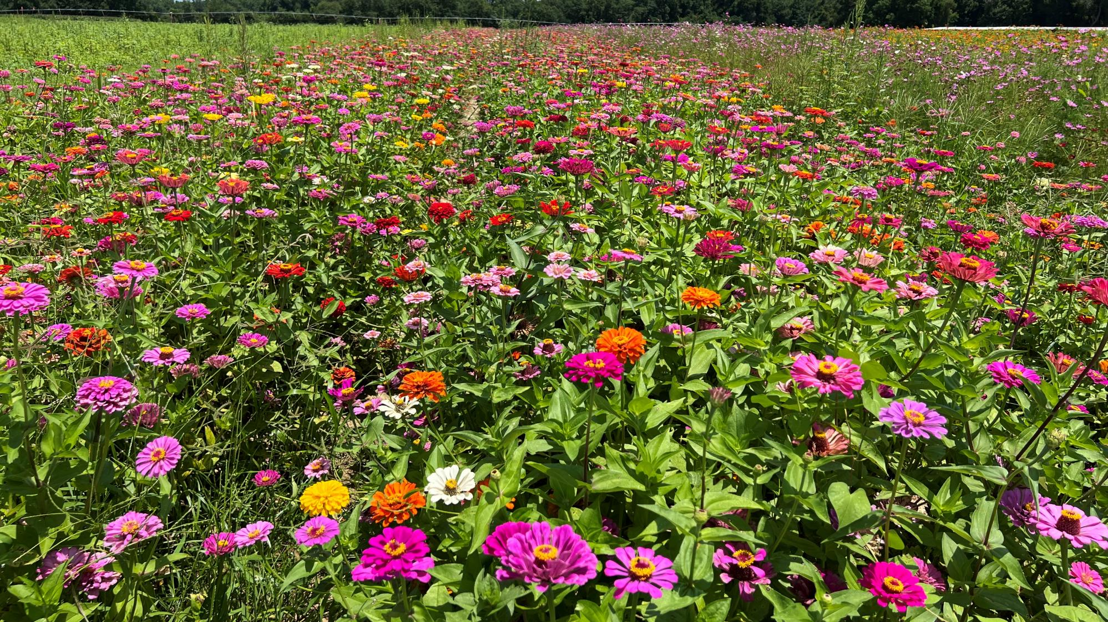

Call anytime with questions!

